Slide 1
Eye Tracking Software

Slide 2
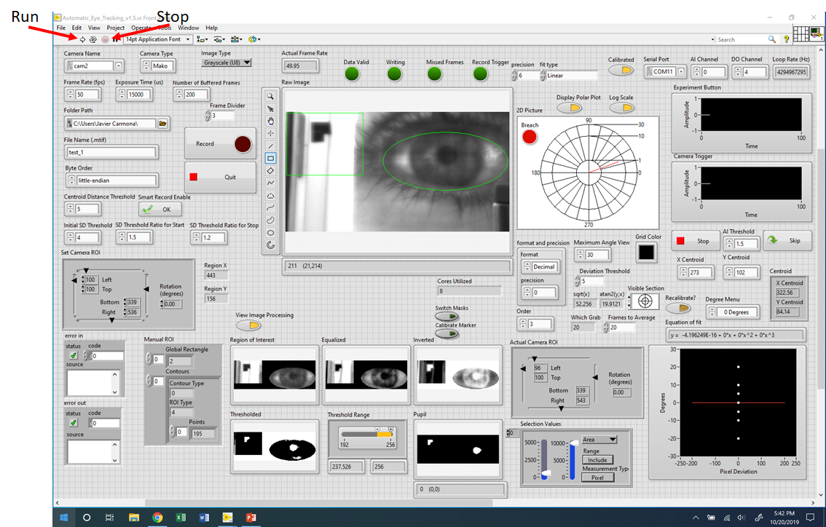

Slide 3
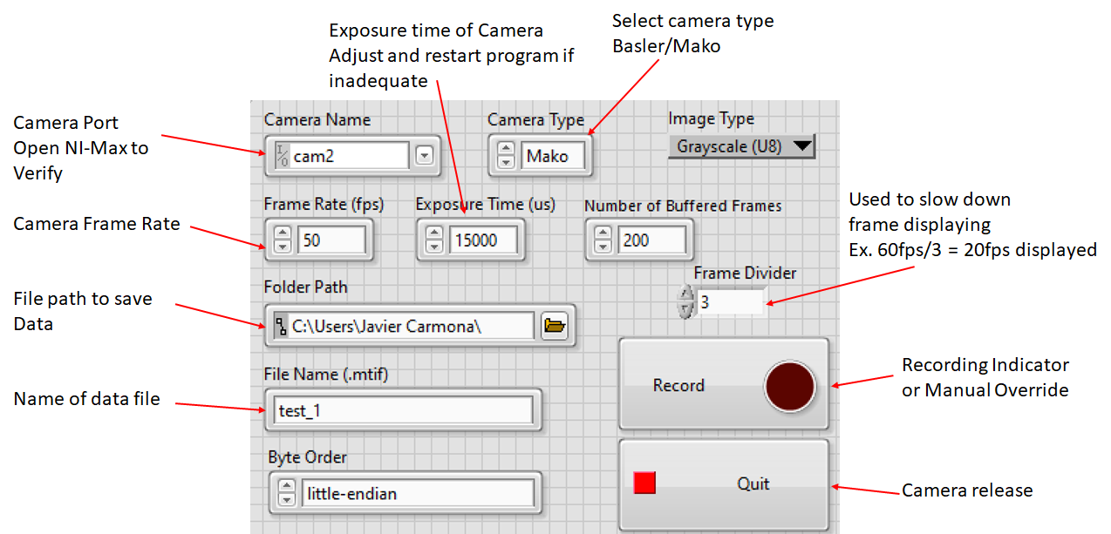

Slide 4
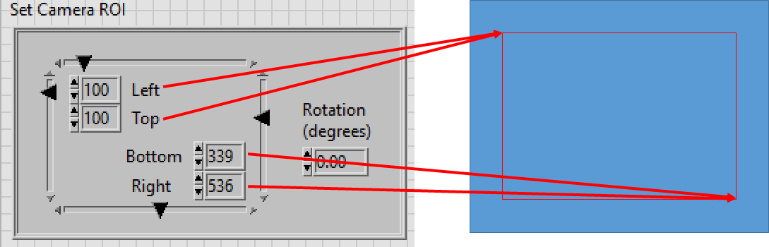

Slide 5
Uploading Firmware to Arduino

Slide 6
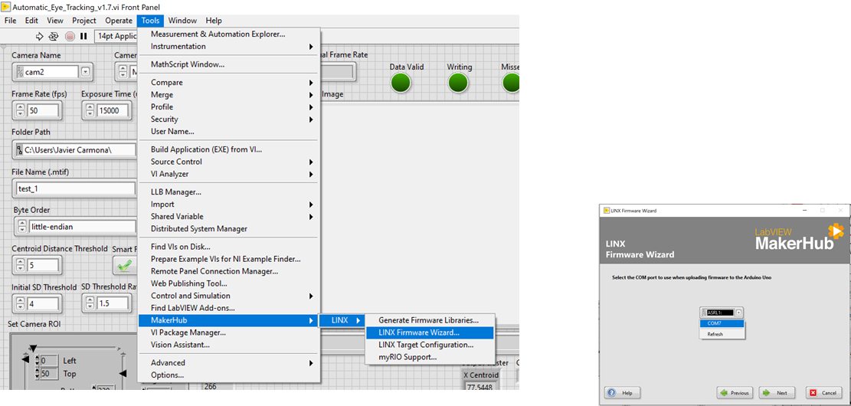

Slide 7
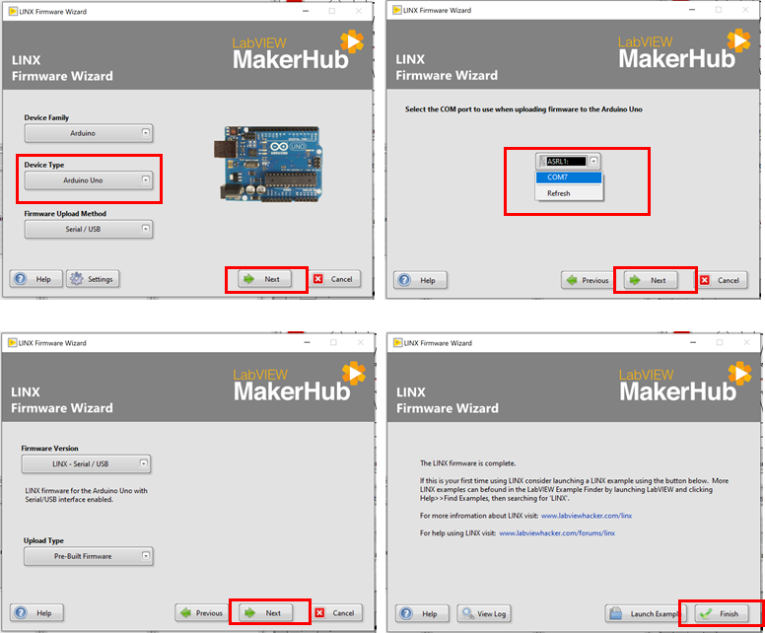

Slide 8
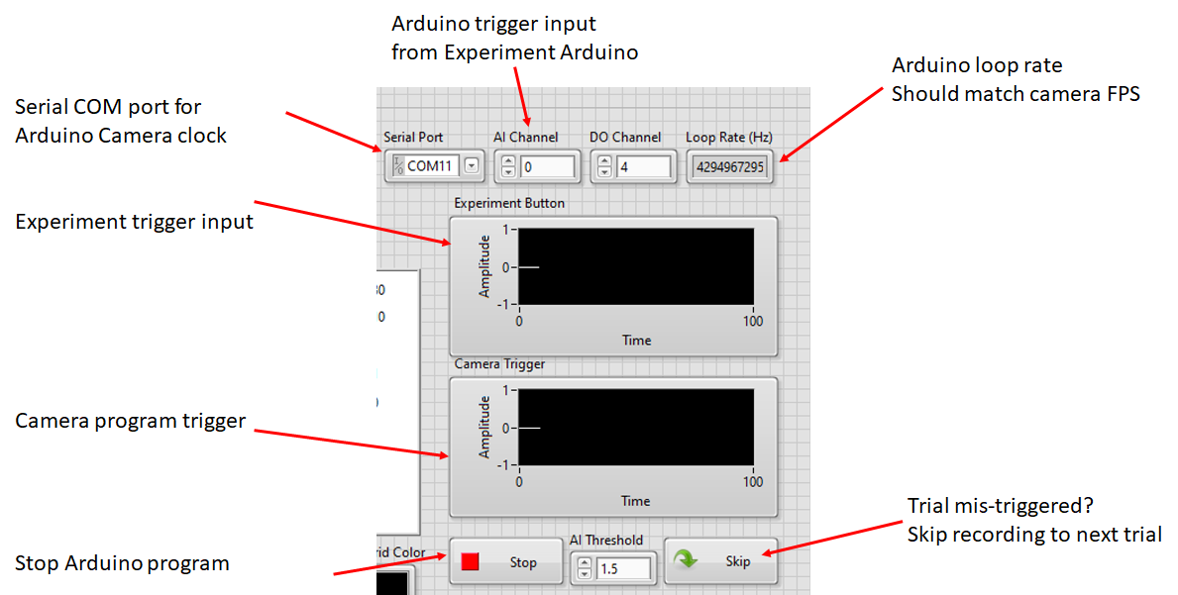

Slide 9
Automated Eye Tracking Features

Slide 10
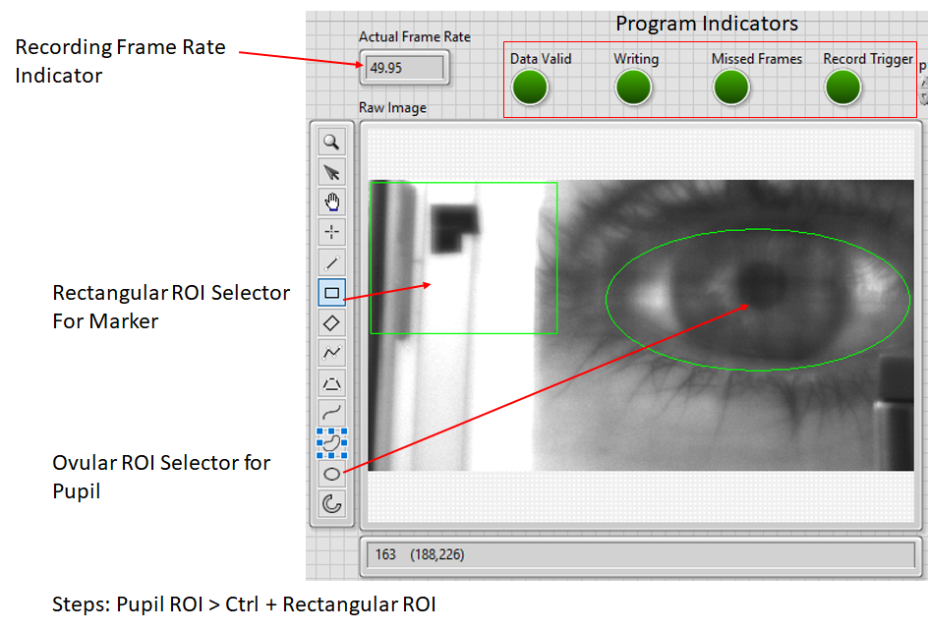

Slide 11
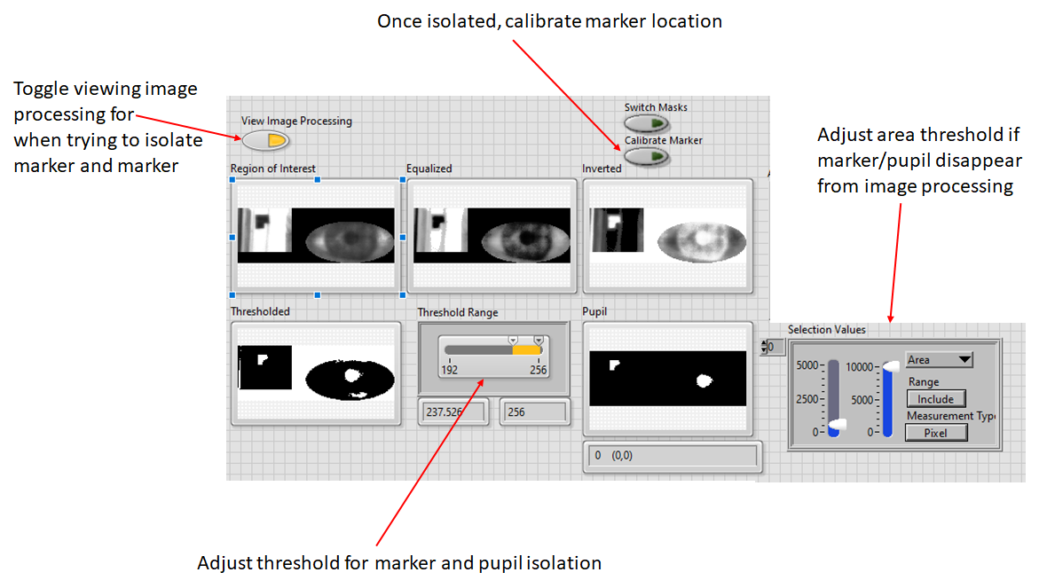

Slide 12
Offline Eye Tracking (In Progress)

Slide 13
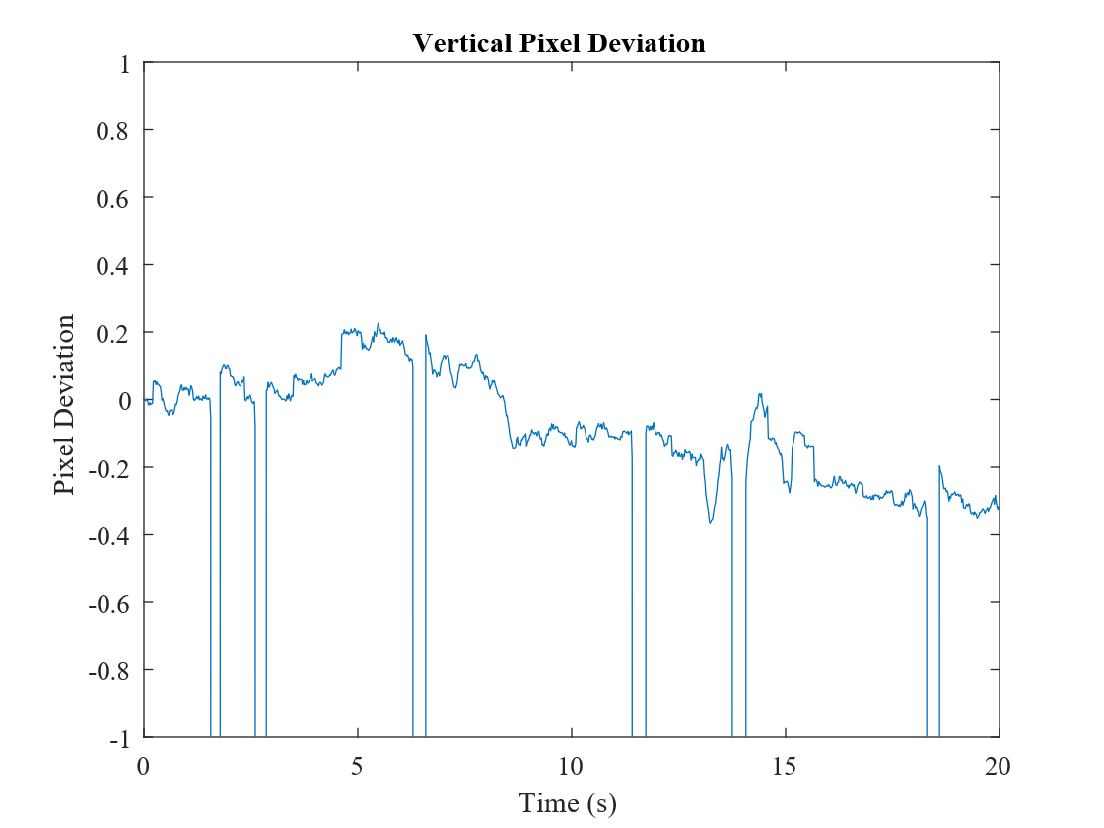
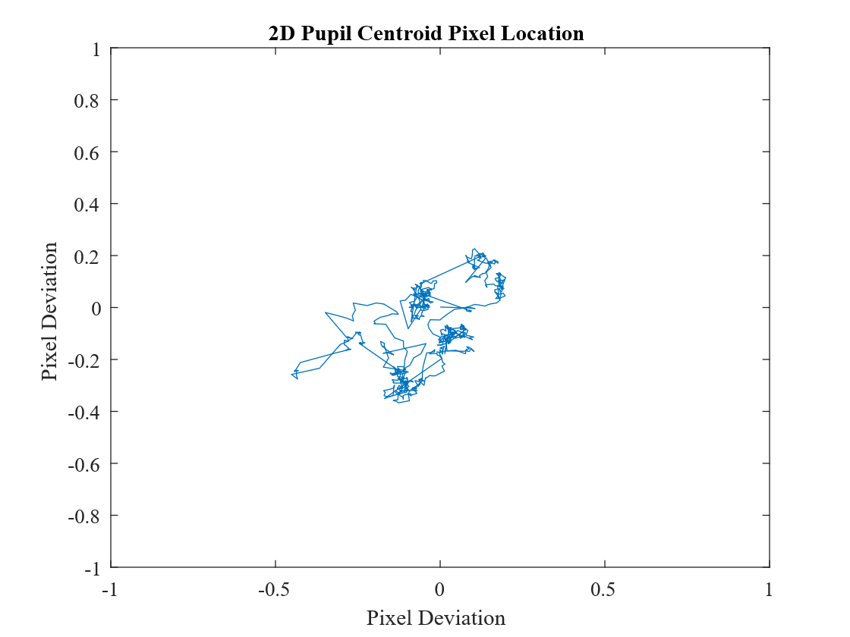
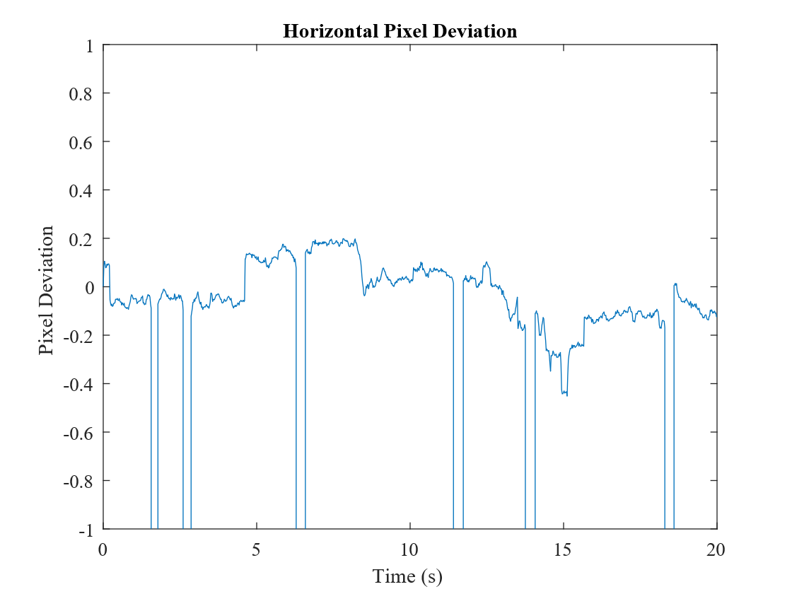
What needs to be done:
Calibration of system
Currently only tracking pixel deviation.
Once calibrated, then we can determine whether a saccade happened, and not just from trial to trial movement
Automated inclusion of trial location.
Start → Stop
Automated offline tracking in general

